Slide 1
Big Mountain Resort Project
Presented by - Swati Sharma

Slide 2
What is the Problem?
What opportunities exist to effectively develop and implement a new pricing strategy that can maximize capitalization and increase revenue to offset their recent operating cost by $1,540,000 this season.

Slide 3
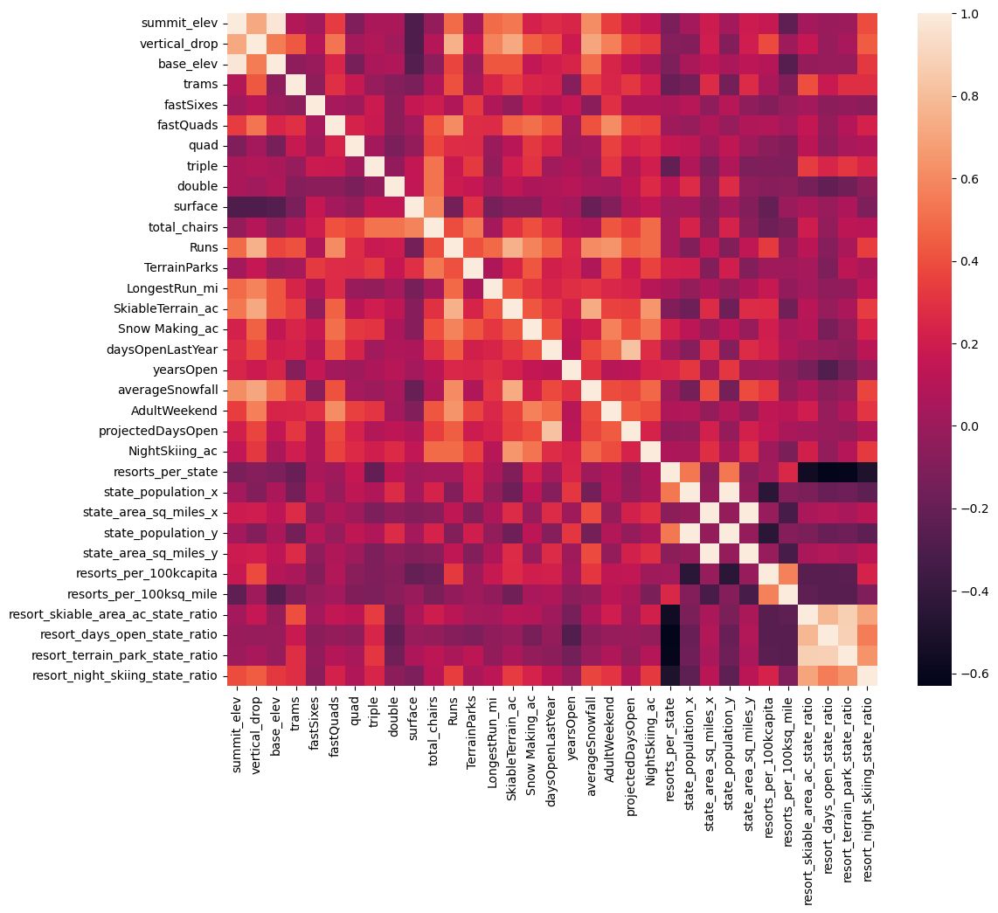
Exploratory Data Analysis
Gain a high level view of relationships amongst the features
Resorts situated with densely located population provides night skiing too, as there is some positive correlation between the ratio of night skiing area with the number of resorts per capita
A night skiing capacity is positively related to the price a resort can charge.
Runs, total_chairs is positive correlated with ticket price too. High the total no. of chairs, higher the ticket price.

Slide 4
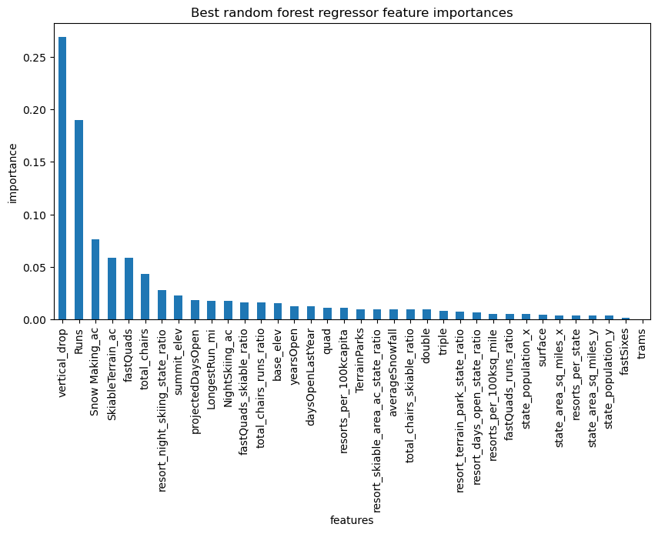
Further Analysis via Pre-processing and Training data
Identified dominant features using Random forest regression model
Vertical_drop
Snow Making_ac, total_chairs
fastQuads
Runs,
LongestRun_mi,
trams
SkiableTerrain_ac

Slide 5
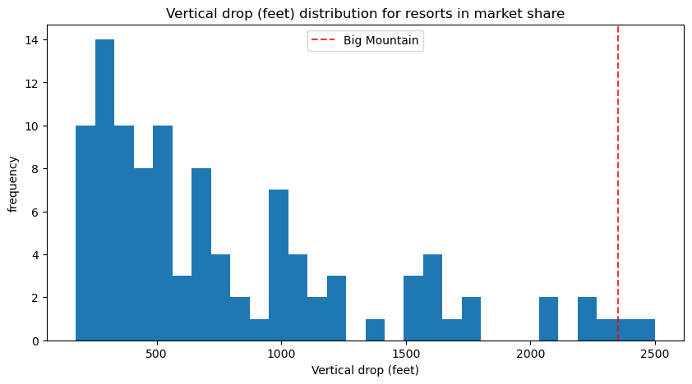
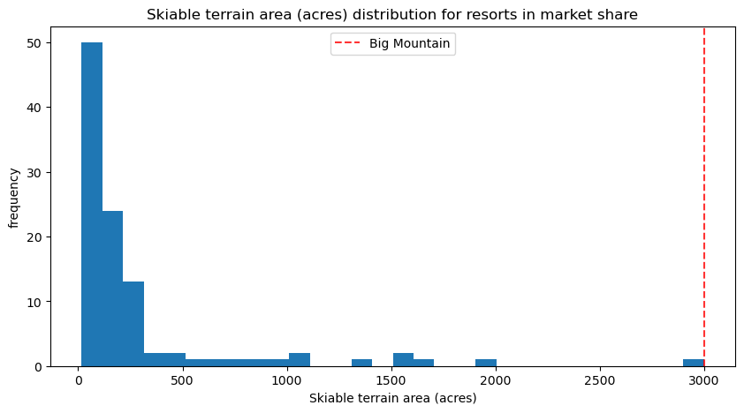
Modeling Results and Analysis
Graphically compare the distribution features such as vertical_drop, Snow Making_ac, total_chairs, fastQuads, Runs, LongestRun_mi, trams and SkiableTerrain_ac
Doing well for vertical drop.
Big Mountain tops the league table of snow making area.
Highest number of total chairs
Big Mountain is amongst the resorts with the largest amount of skiable terrain.

Slide 6
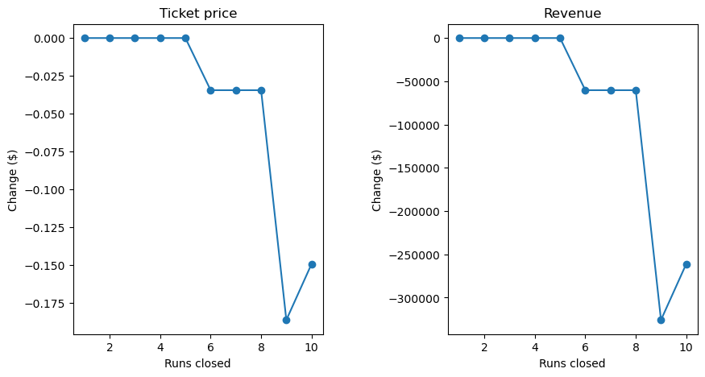
Recommendation and Key Findings
Resort can close unto 5 runs as there is no revenue impact until, closures down to >=6
Big Mountain Resort modeled price came as 90.12 dollars with expected mean absolute error of 9.57 dollars, suggest a room for increase in ticket price.
Recommended Scenario:
Adding a run, Increase the vertical drop by 150 feet, and install an additional chair lift - Justify ticket price support by $0.14 which totaled to $247768 over the season.

Slide 7
Summary and Conclusion
Big Mountain is an upscale resort with some of the best amenities and facilities among other resorts in US which can be unitized more.
Room for increase in ticket price.
Would be interesting to learn more about day-to-day operational costs, actual number of visitors, that may affect profitability and revenue increase.

